Slide 1
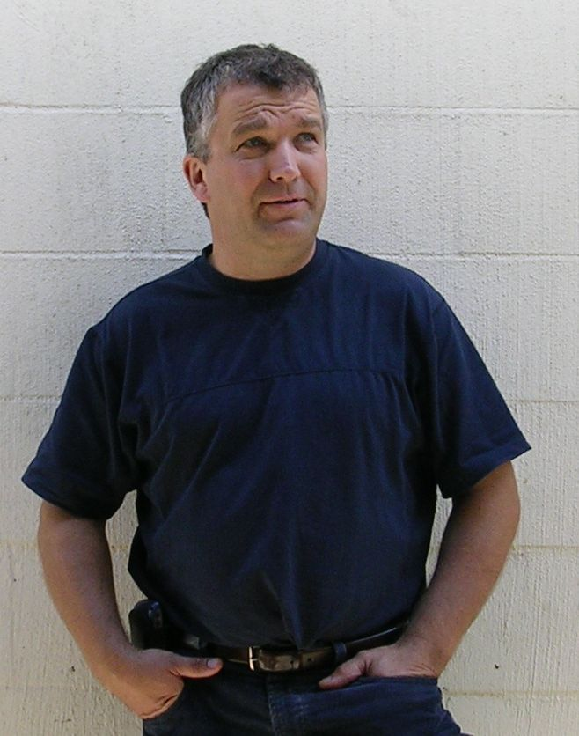




Engineering Meeting
Wednesday 18 November, 7:00-8:30 PM
NEU 36
Featuring
Founder
Adjunct Professor of Mechanical Engineering
Norbert Kott
“Engineering: Becoming an Apprentice in the Creation Department of God’s Kingdom”
Also speaking:
Dr. Arnold Sikkema
TWU Coordinator of Engineering Transfer
“Tips for a Successful Transfer to UBC (or elsewhere)”
RSVP Arnold.Sikkema@twu.ca by noon Tuesday

